Slide 1
TE E&TC Mini project (304200)
“Water Pollution Monitoring RC Boat”
Roll No. Student Name 05 Rahul Beeraladinni
14 Dnyanesh Dahiwadkar
50 Ketan Patil
K. K. Wagh Institute of Engineering, Management and Research, Nashik
Savitribai Phule Pune University, Pune
Guided By
Prof. M. V. Marathe

Slide 2
Content
1.Objective of project
2. Block diagram
3. Circuit diagram (Simulation )
4. Working
5.PCB Layout
6.Testing (include photographs of breadboard testing, PCB testing and final model testing)
7.Application
8.Advantages
9.Results and Conclusion
10.References

Slide 3
Objective of Project
The objective of a water pollution monitoring RC (remote-controlled) boat is to collect data and monitor the quality of water in various bodies such as lakes, rivers, reservoirs, or coastal areas.
The objective of deploying a water pollution monitoring RC boat is to enhance our ability to assess and manage water quality effectively, leading to better protection and sustainable management of our water resources.

Slide 4
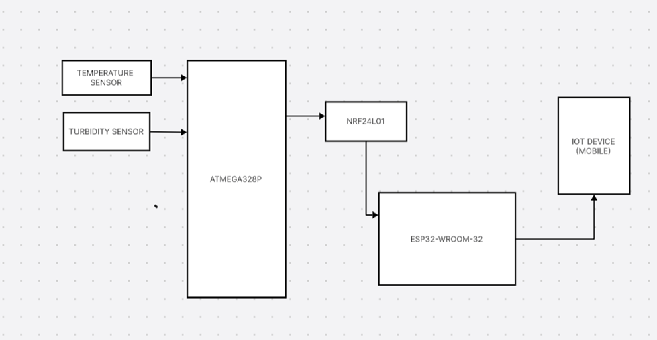
Block Diagram
Fig1.1 Block Diagram

Slide 5
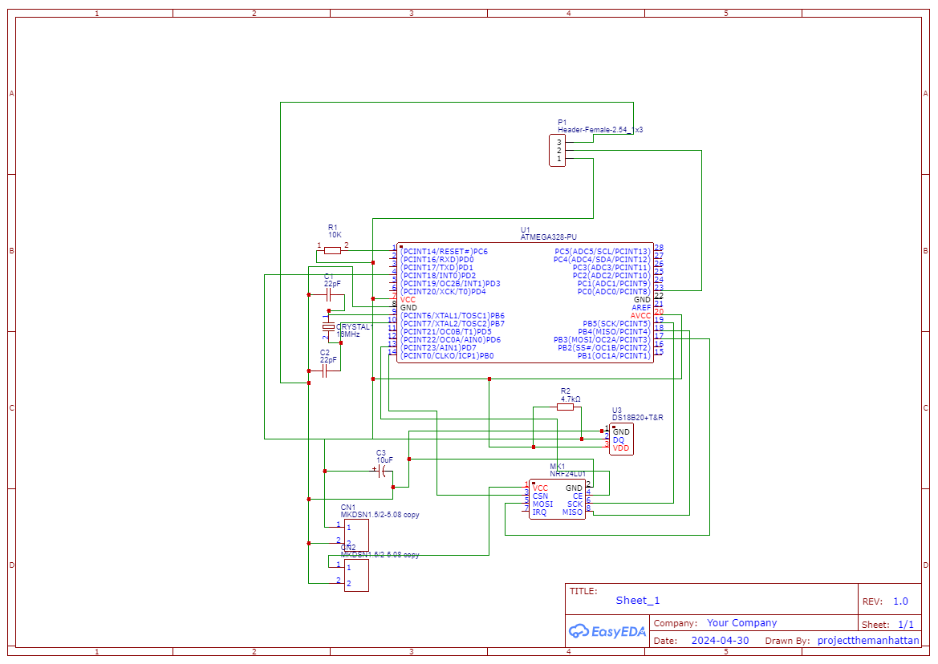
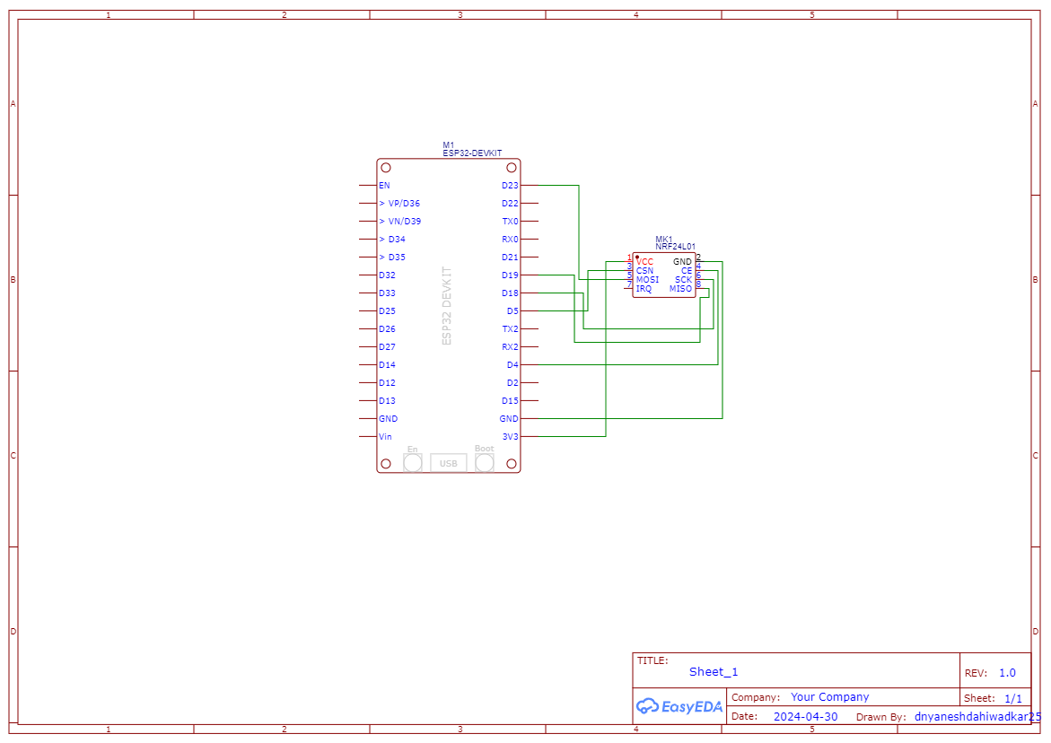
Circuit Diagram
Fig 1.2 Circuit Diagram of Tx
Fig 1.3 Circuit Diagram of Rx

Slide 6
Working
Turbidity sensor and Temperature sensor are connected to PC0 and PD2 pin of ATmega328P.Which provides the required sensor values.
The NRF24L01 module (Transmitter) connect to Microcontroller used to Transmit the Data to Esp32 .
The Receiver module is connected at the Receiver used to receive the transmitted signal and further pass it to ESP32 .
ESP32 which is connected to Blynk used to display the data on Mobile.

Slide 7
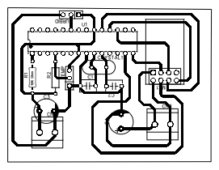
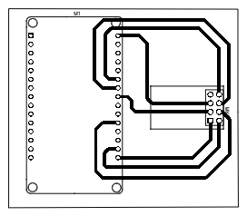
PCB Layout
Fig 1.3 Transmitter PCB Layout
Fig 1.4 Receiver PCB Layout

Slide 8
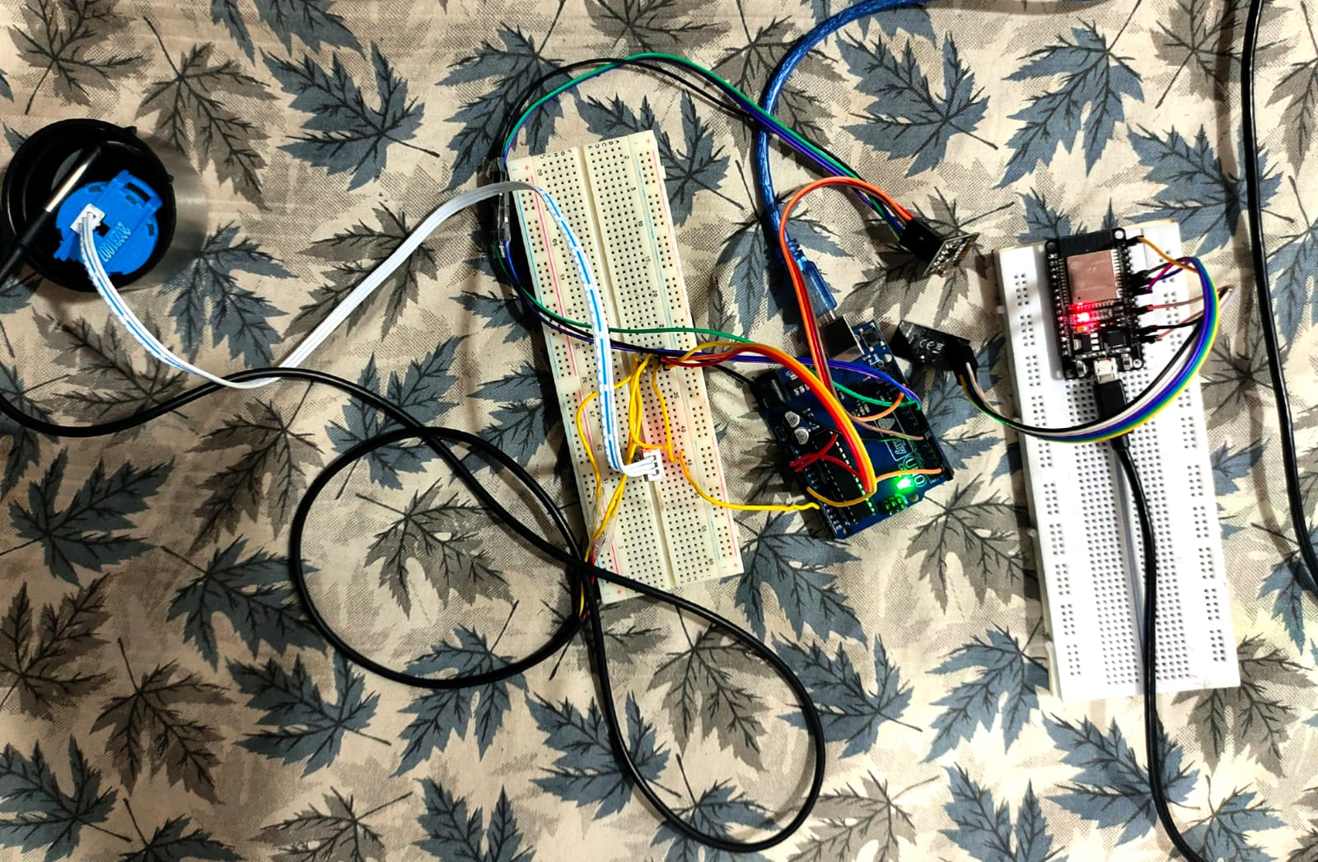
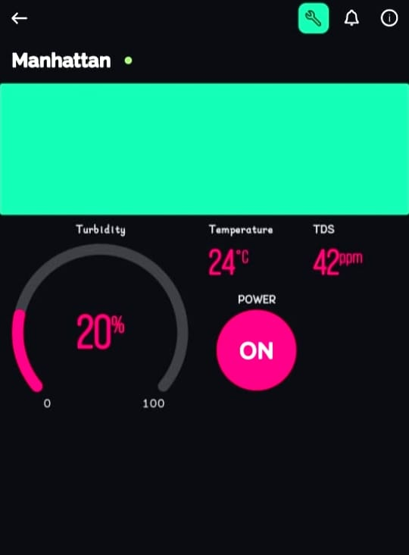
Testing
Fig1.1 BreadBoard Testing
Fig1.1 Blynk App

Slide 9
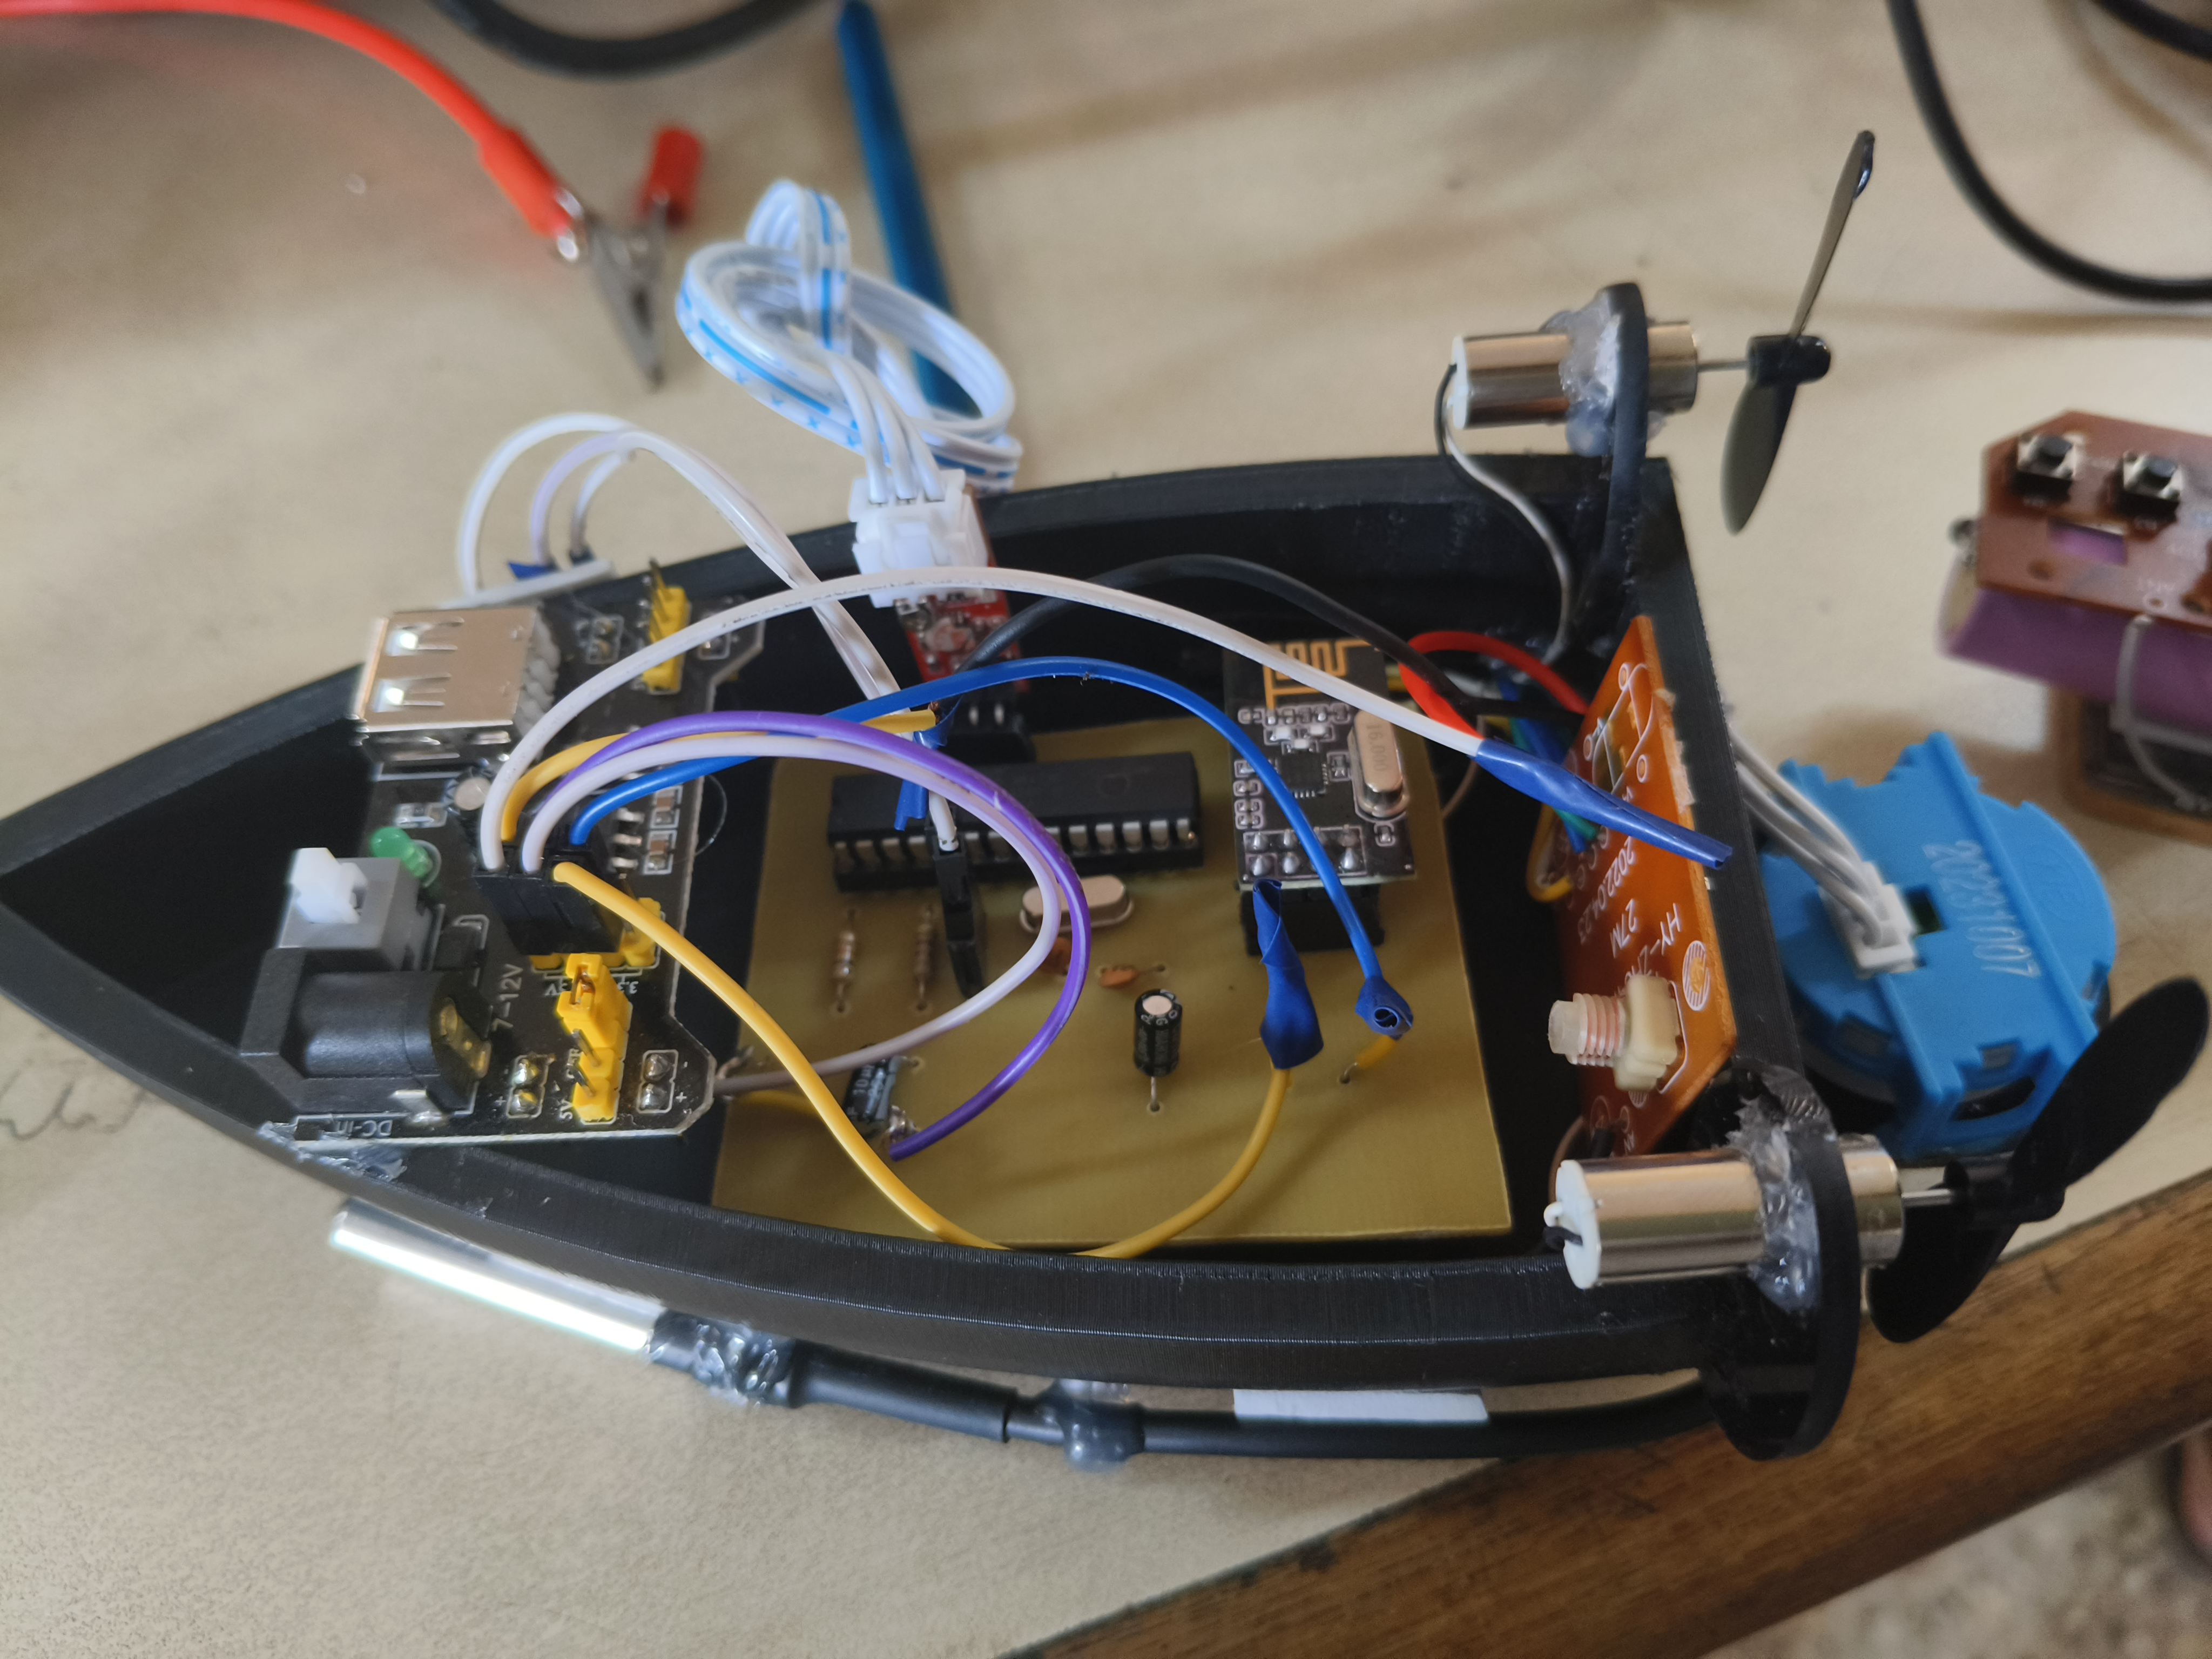
Testing
Fig 4.1 Final Testing

Slide 10
Applications
Environmental Research and Management.
Pollution Detection and Surveillance.
Aquatic Resource Management.
Ecosystem Monitoring.
Research and Education

Slide 11
Advantages
Water Sampling.
Remote Monitoring.
Adaptability to Different Sensors.
Real-Time Data Collection.
Cost-Effective Solution.

Slide 12
Result and Conclusion
We measured the temperature of normal water which came out close to the room temperature. This test was carried out first so that the reading could later be used for the comparison between other samples of water. The sensor was cleaned and then inserted in hot water and later dipped in cold water to gather the readings respectively.
Type of Water | Degree C of water
Hot Water | 72.01
Cold Water | 2.46
Normal Water | 27.15
Type of Water | % of Clean Water
Drinking Water | 97.13
Dirty Water | 60.17

Slide 13
References
https://www.sciencedirect.com/science/article/pii/S2666285X2100090X
https://www.ripublication.com/awmc17/awmcv10n5_24.pdf
https://www.researchgate.net/publication/353853205_IoT_based_Smart_Water_Qualit

Slide 14
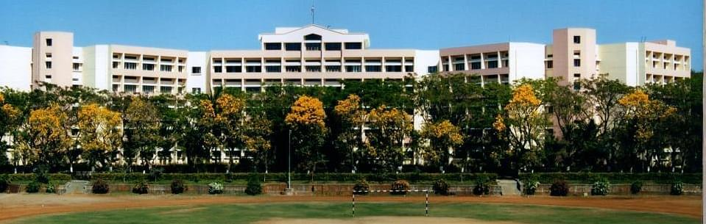
Thank You

